Slide 1

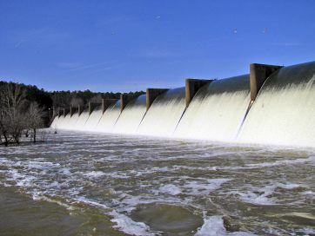
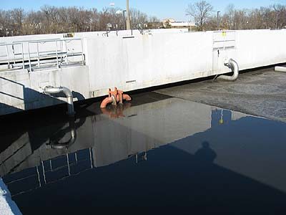
WATER & WASTEWATER 101
PRESENTED BY DEPARTMENT OF UTILITIES
Presenters: Daniel Harrison & Jerry Byerly

Slide 2

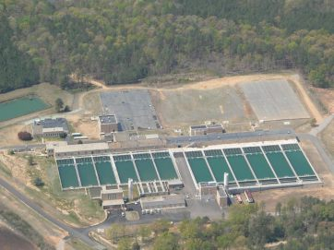
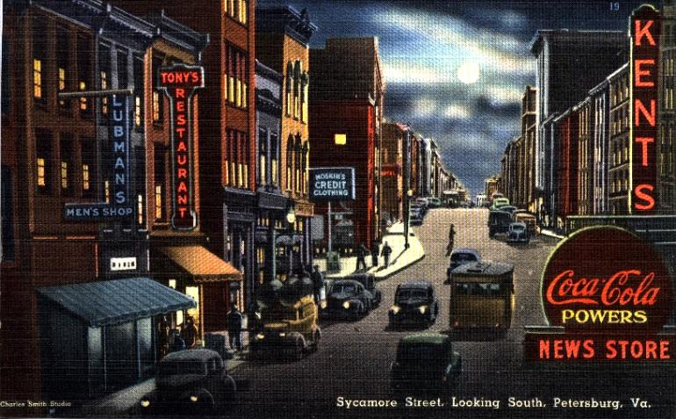
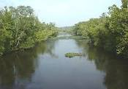
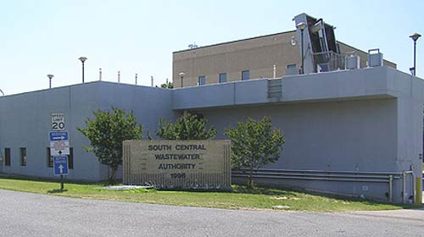
ARWA
City of Petersburg
Clean Water
Appomattox River
SCWWA
Treated Wastewater

Slide 3

Lets talk about Water
  What is the Appomattox River Water Authority (ARWA) and what does ARWA do?
    ARWA takes raw water, converts it to safe drinking and then delivers it to the Petersburg water utility distribution system
  How are ARWA rates determined?
    Rates are determined based upon the percentage of capacity each of the members is entitled to use. Petersburg is 16%. That means we pay for 16% of all operating cost and capital costs to run ARWA
  How do ARWA rates impact City of Petersburg?
    Petersburg rates are determined by adding ARWA rates to our operating and capital cost
  How does the City of Petersburg distribute water from ARWA to it’s customers?
    Water is distributed through a network of pipes, pumps and water towers

Slide 4
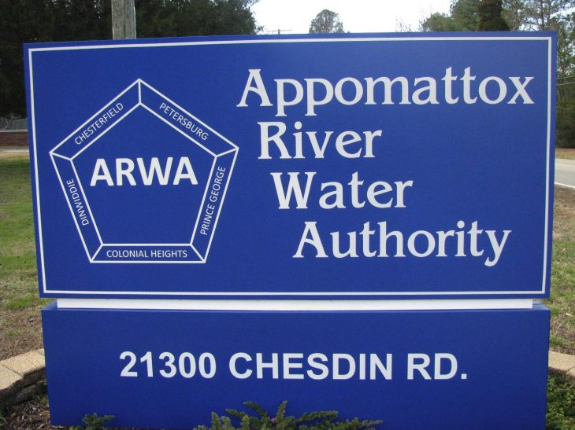


Slide 5


ARWA charges its members a rate that will build and maintain its water distribution infrastructure.

Slide 6

  How do ARWA’s rates impact City of Petersburg
  ARWA charges Petersburg $0.9017 per 1000 gallons
  Cost to producing a gallon of water (ARWA Rates) + Operation and Maintenance cost Petersburg + Capital Improvement Plan (CIP) + Reserves = City of Petersburg Water Rates

Slide 7
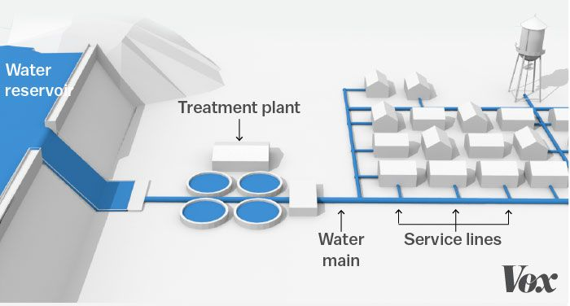
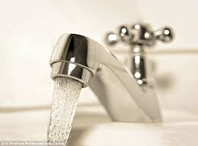
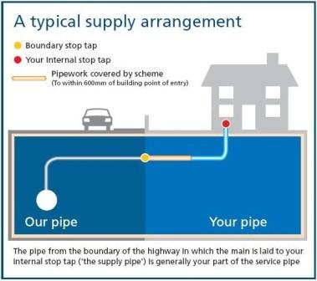
How does City Distribute Water to it’s customers?

Slide 8
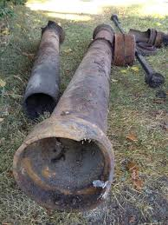
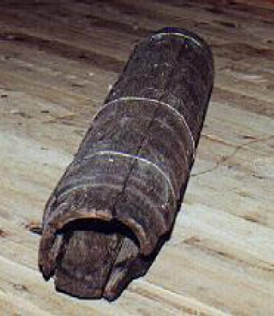
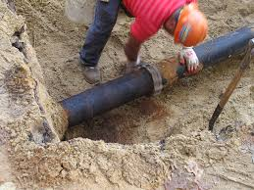
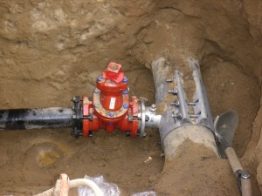
City of Petersburg
Water System Map

Slide 9
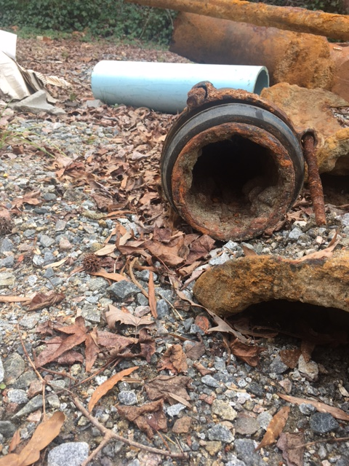
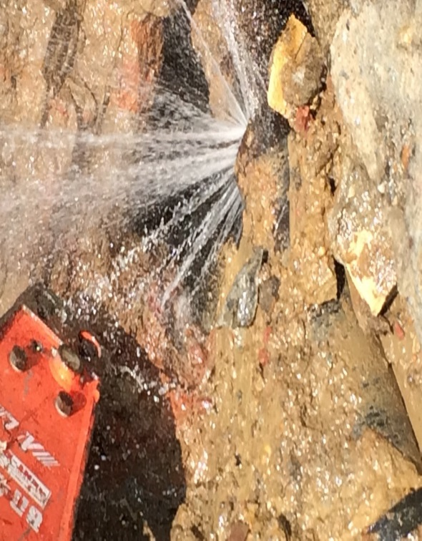
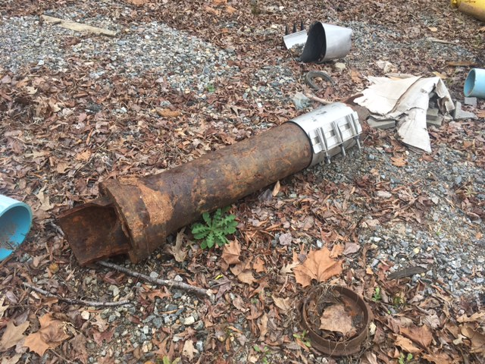
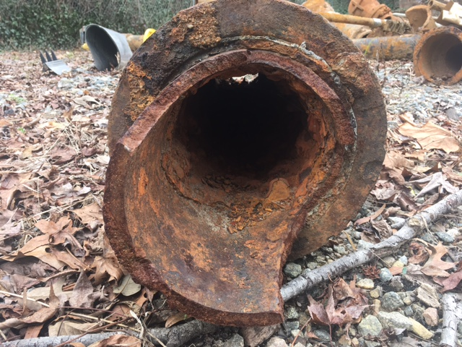
No CIP for over 25 years

Slide 10
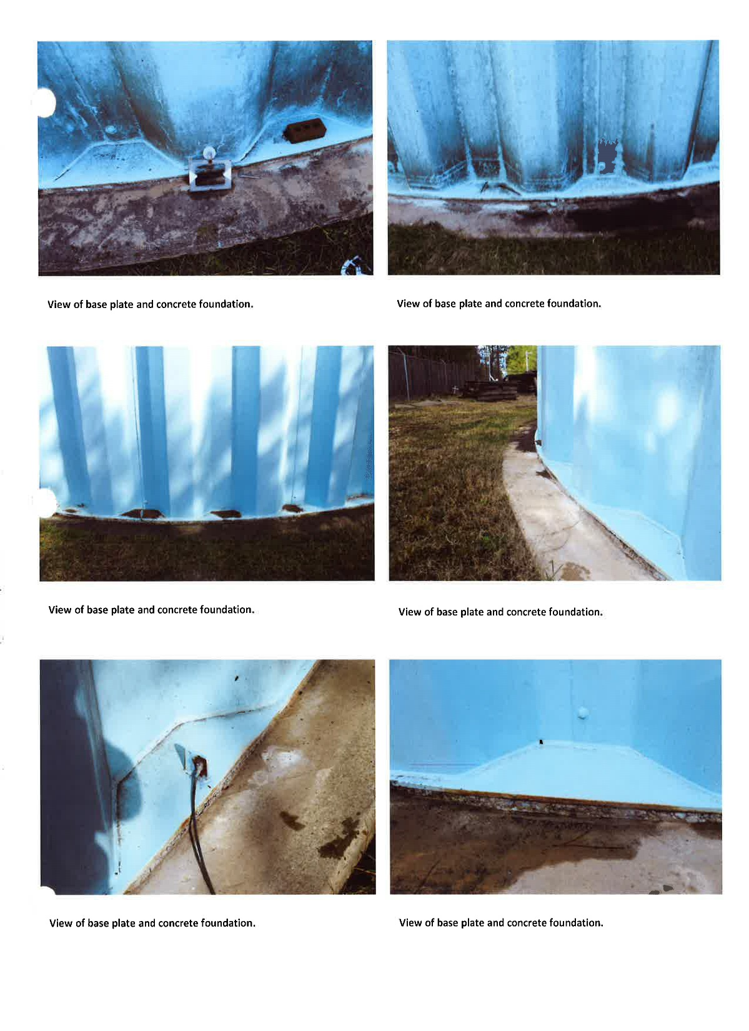
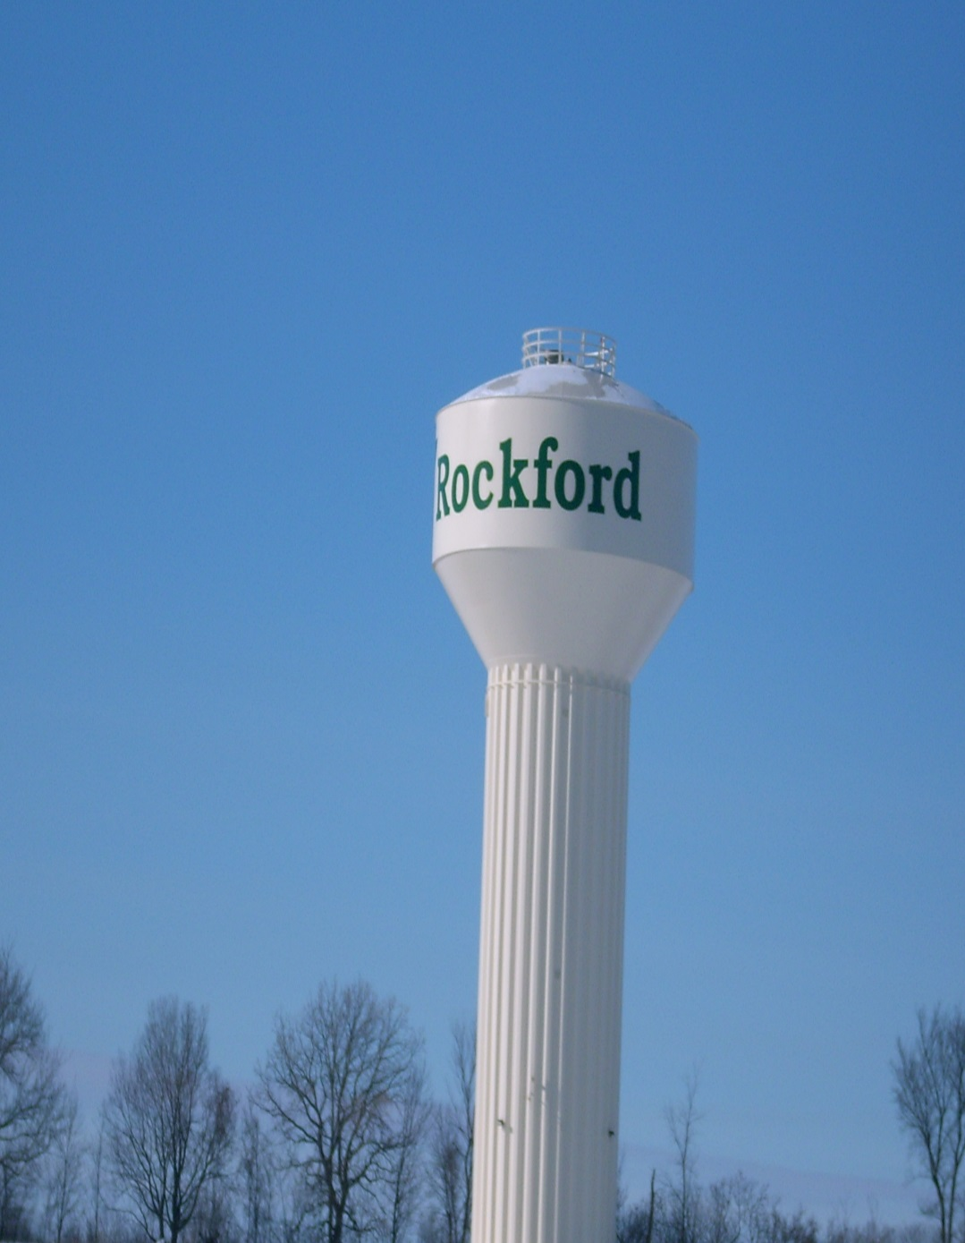

Slide 11
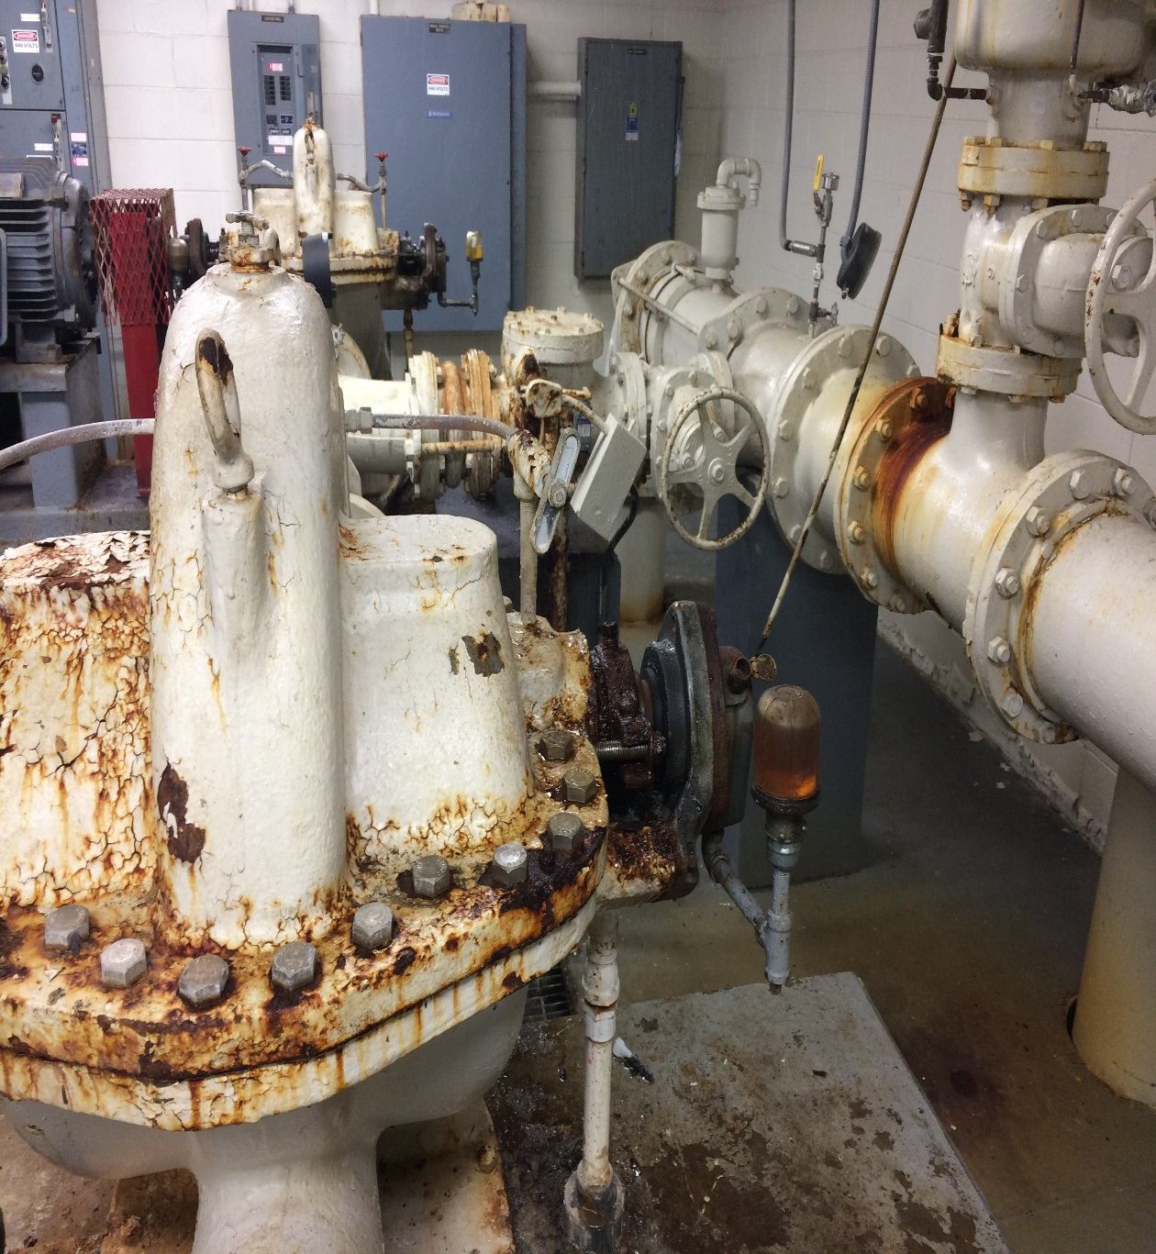
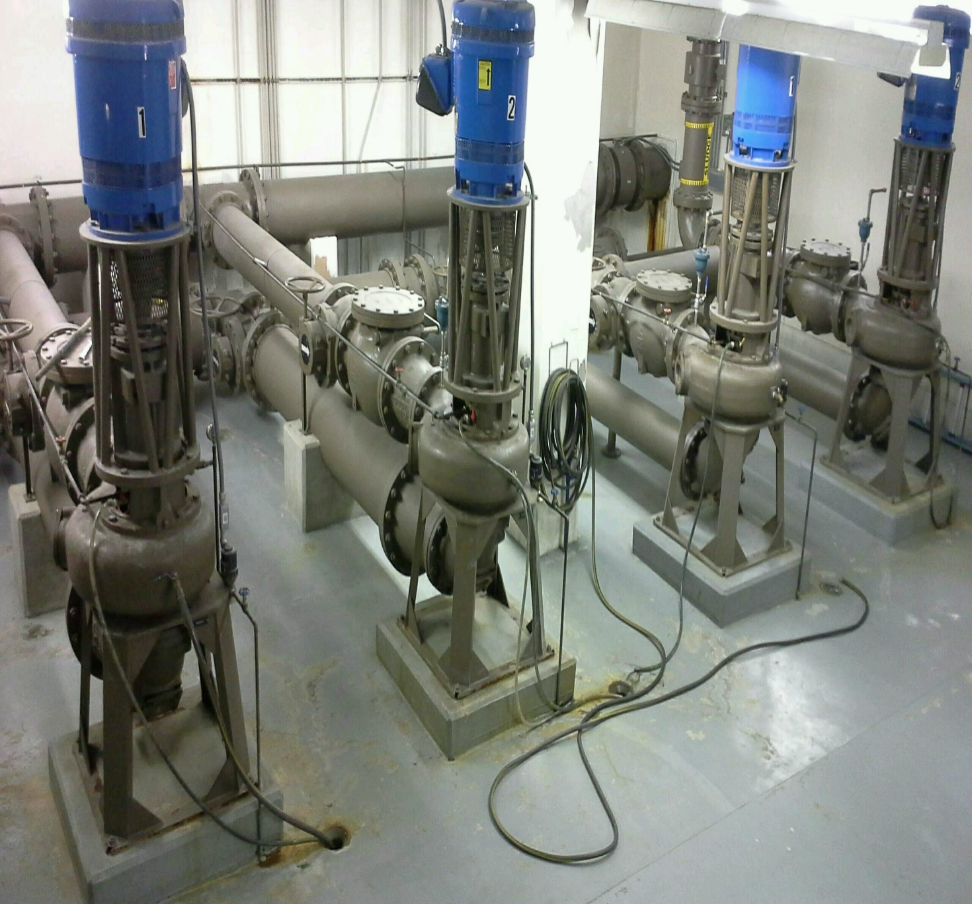
City of Petersburg Water Pump Station
Waster water station in NC

Slide 12

Lets talk about Wastewater
  What is the South Central Waster Water Authority (SCWWA) and what does SCWWA do?
    SCWWA receives all of the raw waste water from Petersburg, converts it to safely releasable effluent water and distributes it into our waterways
  How are waste water rates determined why are they higher than water rates?
    Our rates are based upon the percentage of capacity used by and available to Petersburg. We are 55% of the SCWWA. We contribute 55% of the operating and capital cost to run the plant
  What is the number one factor that impacts waste water rates?
    Inflow and Infiltration
  How does City of Petersburg distribute wastewater from its residence to it’s SCWWA?
    Wastewater is distributed through a series of pipes and pump stations

Slide 14
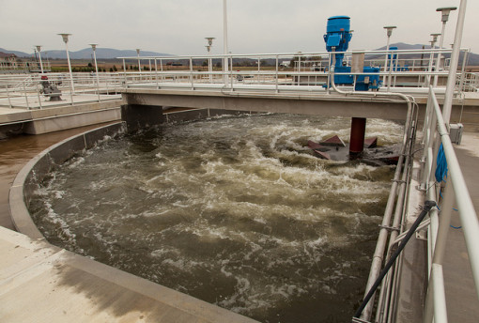

Why are wastewater rates higher than water rates?
Drinking water flows through pressurized pipelines
Complexity of wastewater treatment and regulatory requirements
Waste water must flow down hill impacting construction methods
Aging wasterwater infrastructure is at high risk for Inflow and Infiltration

Slide 15

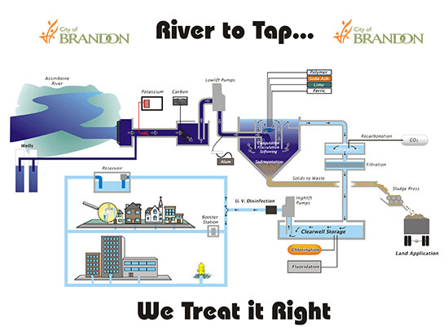

Slide 16
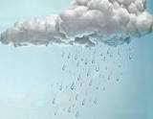
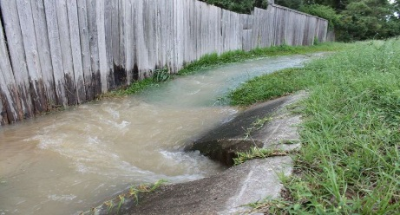
ARWA
1.7 Billion Gallons
Water
Appomattox River
2.7 Billion Gallons Treated

Slide 17
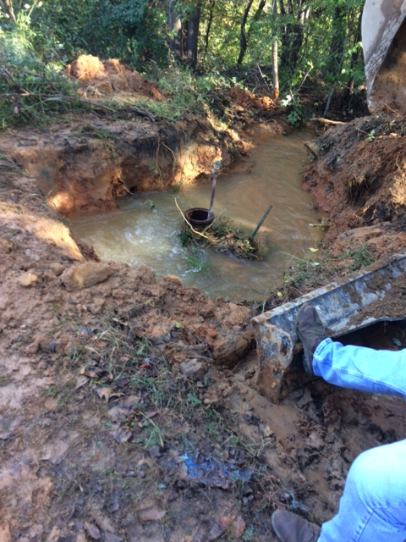
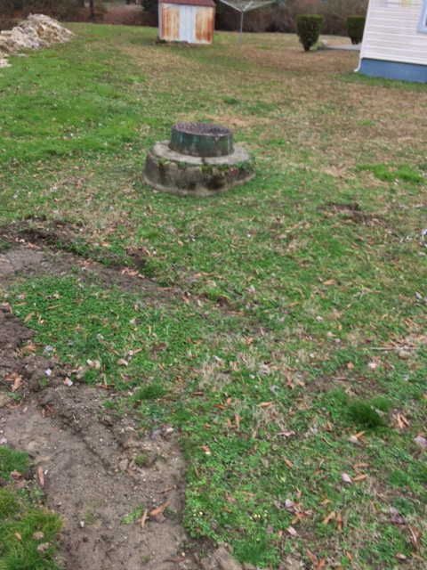
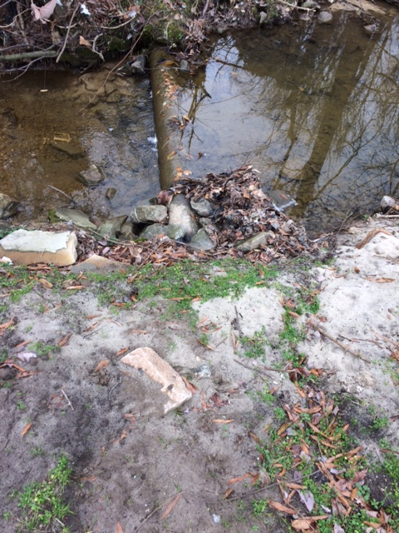
What is the number one factor that can impact waster water rates?
Inflow and Infiltration (I&I)

Slide 18

Talking Points:
City Engineer/Interim PW Director, Utility GM of 30 plus years experience and on call utility engineer when asked to rate the system from 1 to 5, with 1 being the worst and 5 the best gave a average rating of 2.
Lose sleep thinking about:
Will the water main from ARWA to the City suffer catastrophic frailer. Two reported leaks last year one in July 2016 and second in Oct 2016 ? This increases risk of issuing a boil water notice for entire City
Engineering reports noted three sections with thin walls along the Poor Creek line that is located in National Park Service
In the event of catastrophic failure to the water system, will the City have ability to acquire resources soon enough to avoid death or illness of customers?
In the event of catastrophic failure to the wastewater system, will the City be able to avoid a major environmental disaster?

