Slide 1
City Council
Public Hearing
September 1, 2020
Proposed Rezoning
607 High Street
20-REZ-PUD-01

Slide 2
Planning Commission
Public Hearing – July 1, 2020
Request from SC Maplewood Ave, LLC (Mark Baker)
To rezone the site of the former High Street United Methodist Church, to permit a mixed-use development that would include multi-family residential and commercial uses.
As required:
  Signs were posted June 17, 2020
  Ads were submitted June 17, 2020 and June 24, 2020
  27 Adjacent Property Notifications were sent June 24, 2020
607 High Street | T.P. 010-170017
From: R-3, Two-Family Residence district | To: PUD, Planned Unit Development | 1.091 Acres

Slide 3
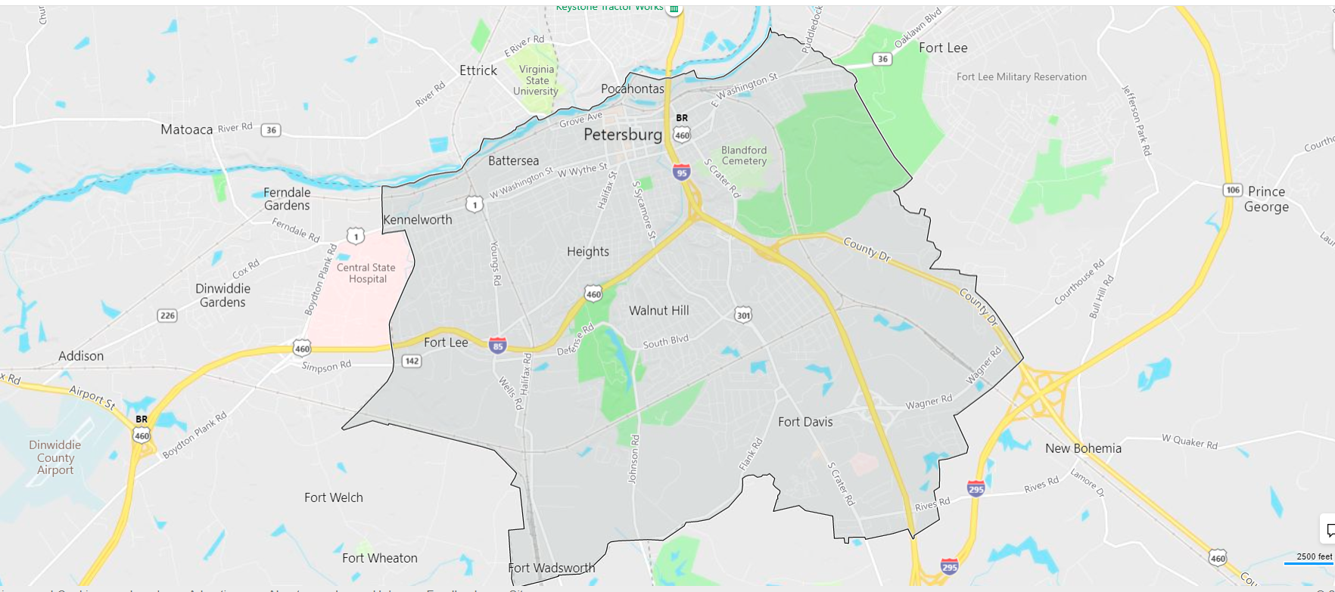
Parcel Locations

Slide 4
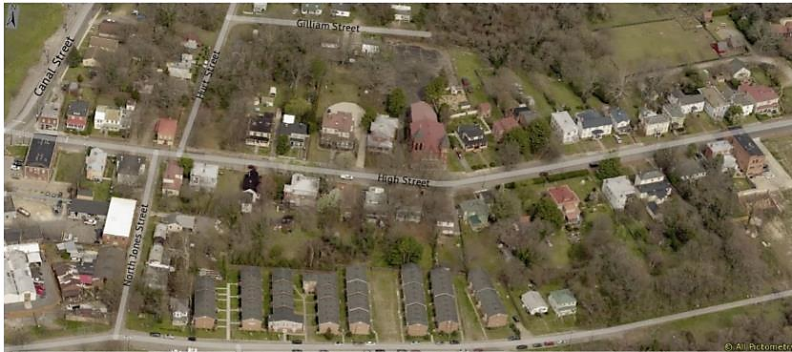
Parcel Location
Four Square Construction
2100 Defense Rd
2045 Squirrel Level Rd
International Paper

Slide 5
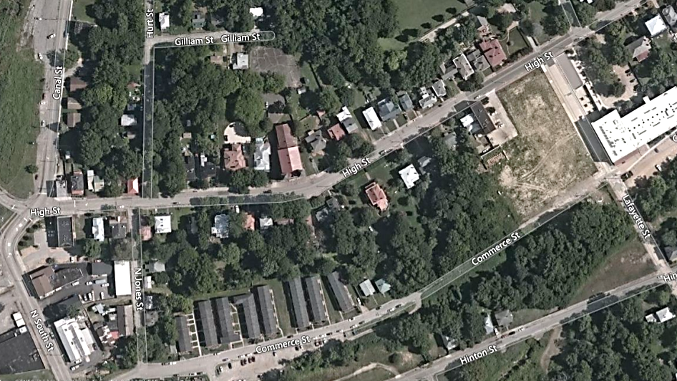
Multi-Family Developments in the Vicinity of 607 High Street
607 High St
719 High St
3 Units
526 High St
9 Units
420 High St
36 Units
714 High St
8 Units
225 South St (UC)
10 Units
607 Commerce St
63 Units

Slide 6
Zoning of Multi-Family Developments in the Vicinity of 607 High Street
607 High St
Proposed
R-3 to PUD
R-3
719 High St
R-3
R-3
R-3
526 High St
PUD
420 High St
PUD
R-3
714 High St
B-2
225 South St (UC)
B-2
607 Commerce St
R-5

Slide 7
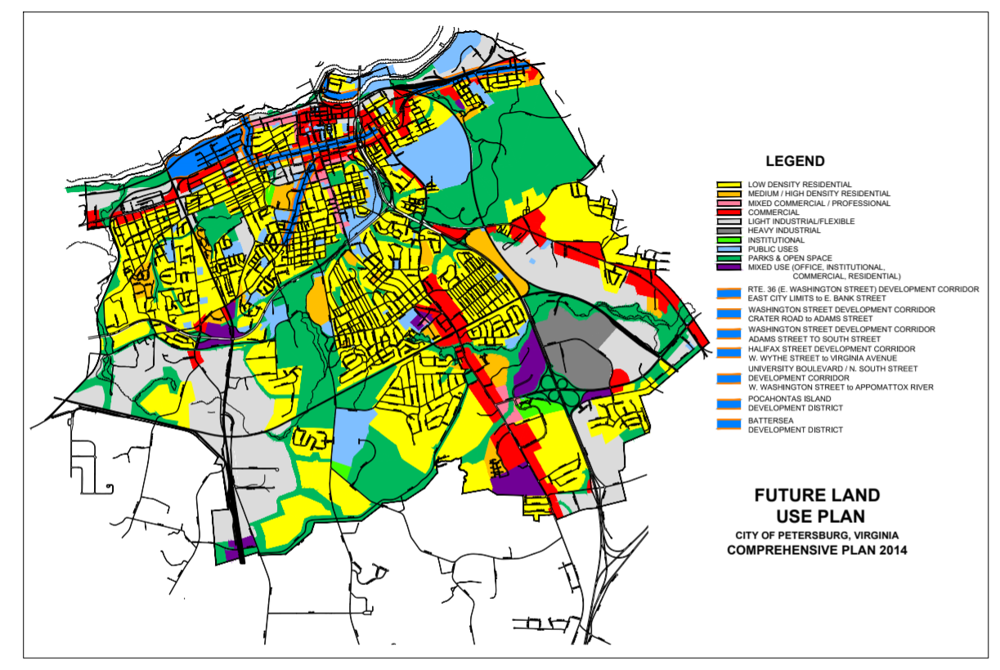
Comprehensive Plan
Future Land Use Plan

Slide 8
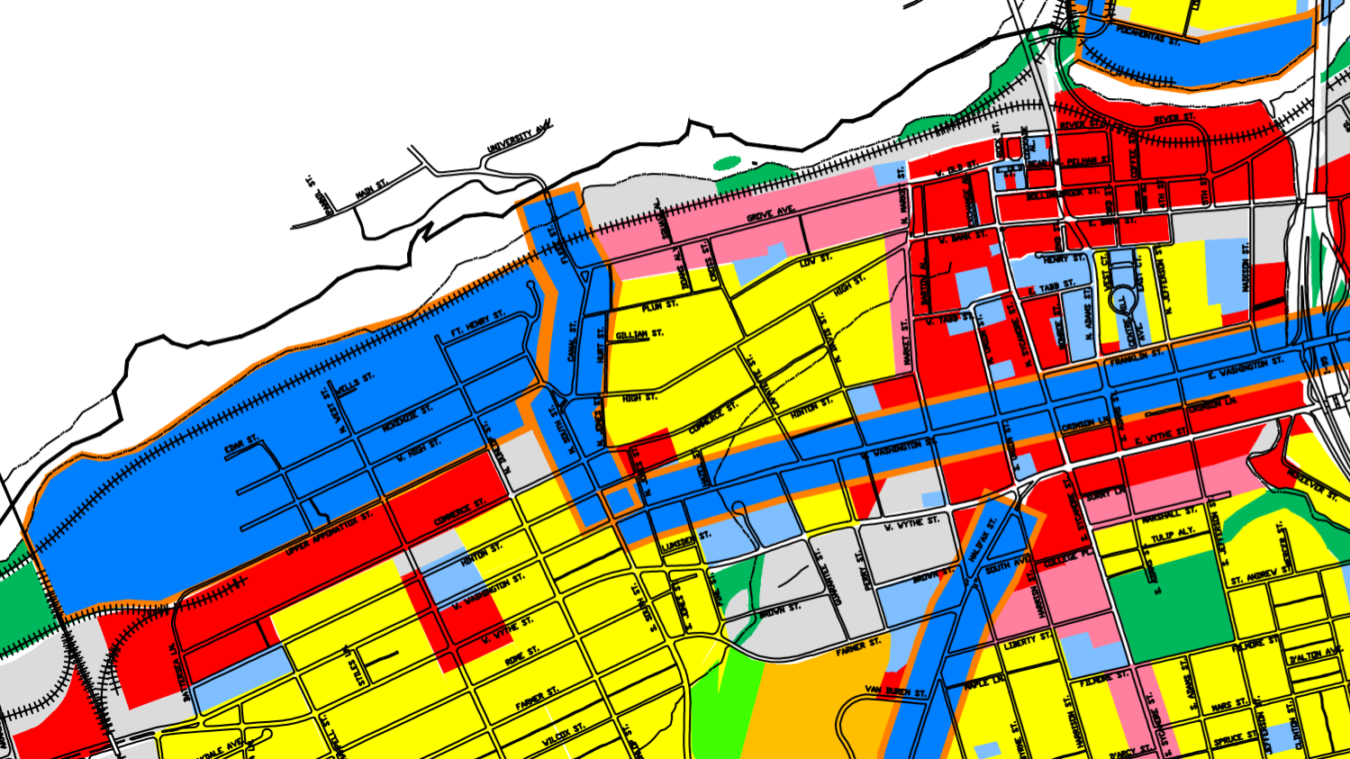
Comprehensive Plan
Future Land - Residential

Slide 9
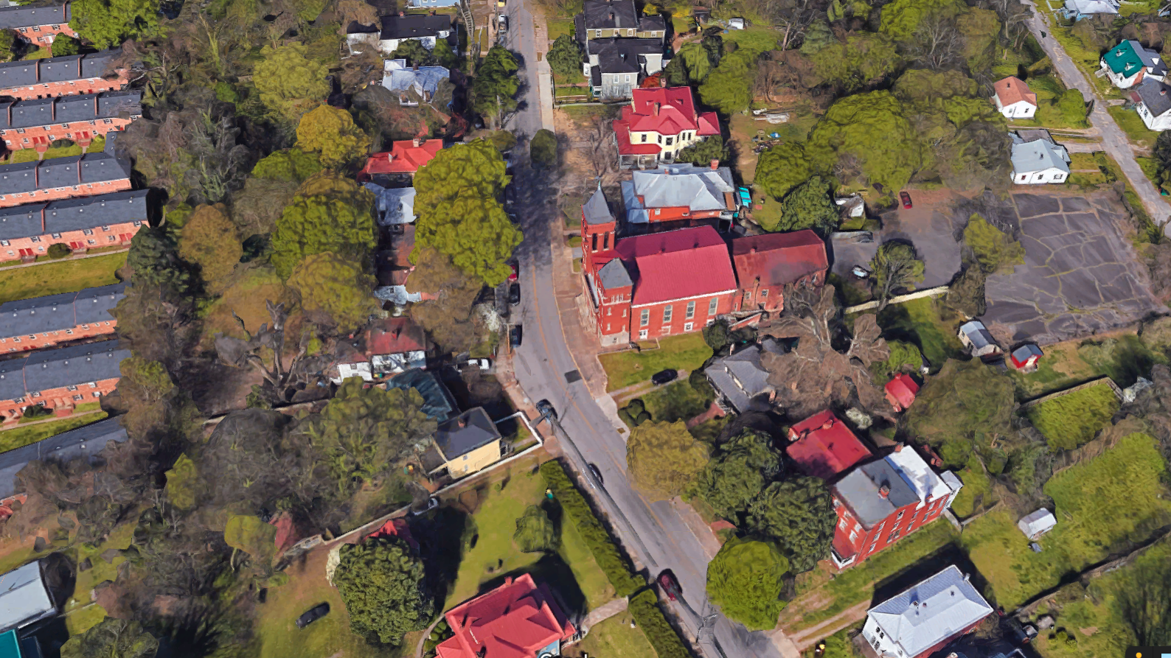
Aerial looking West

Slide 10
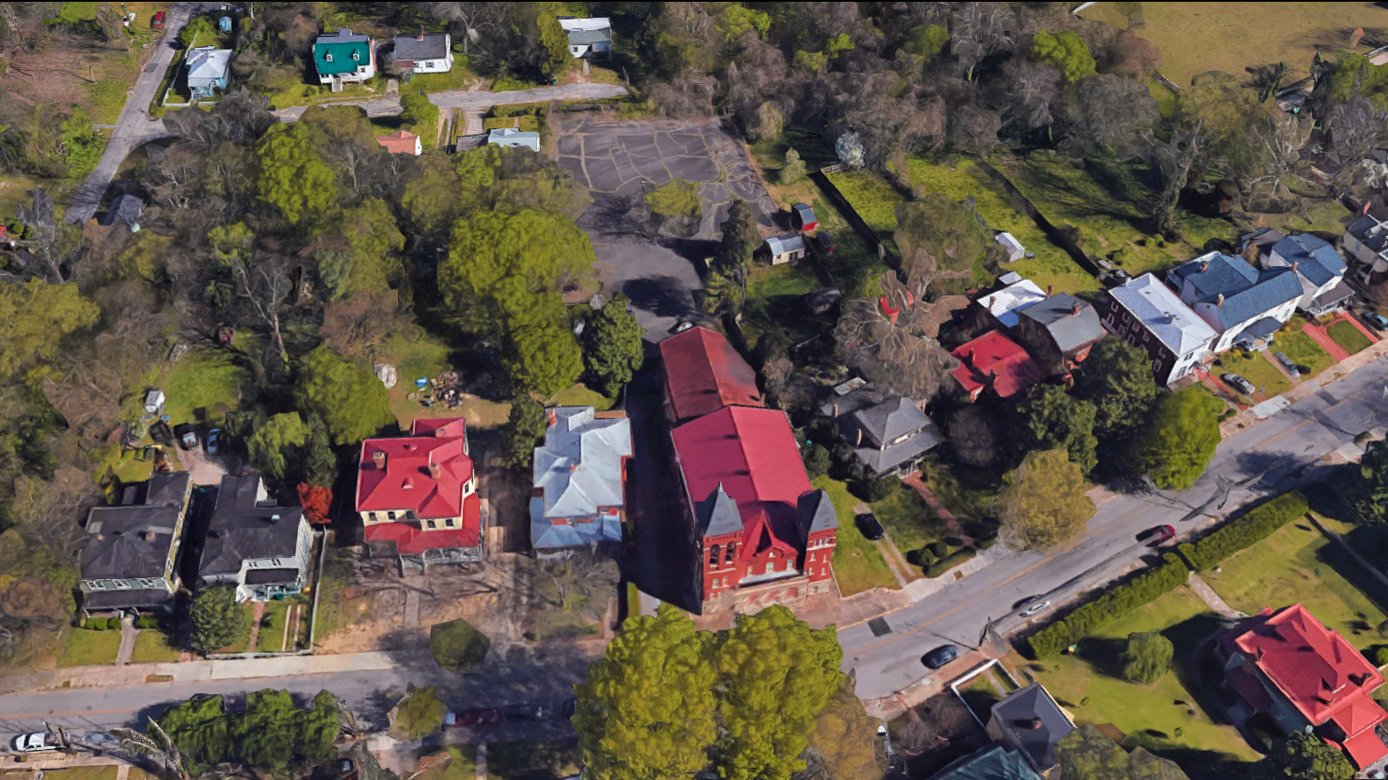
Aerial looking North

Slide 11
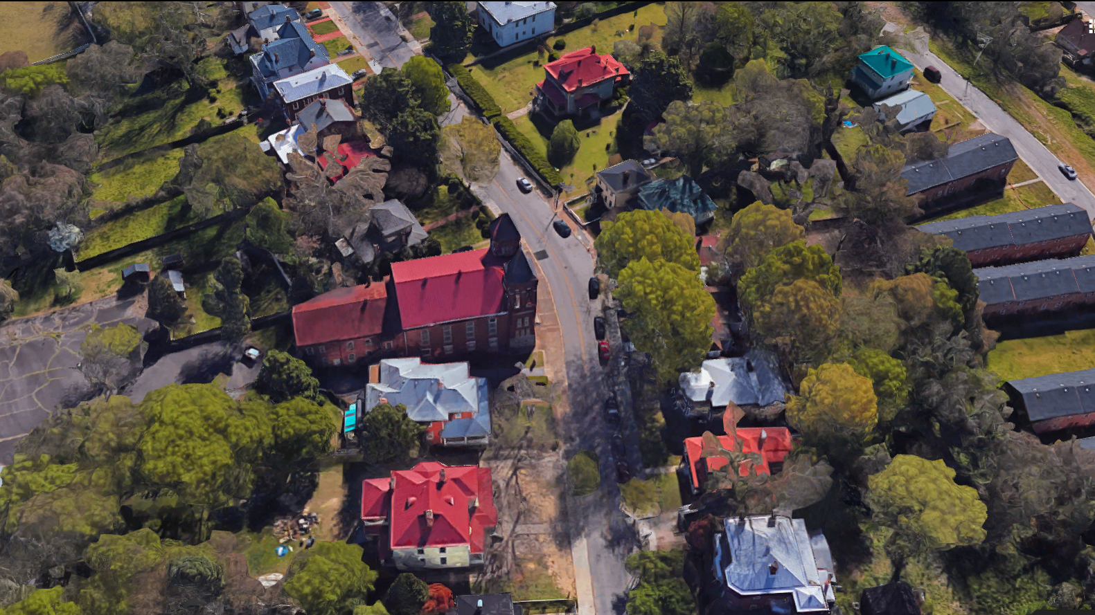
Aerial looking East

Slide 12
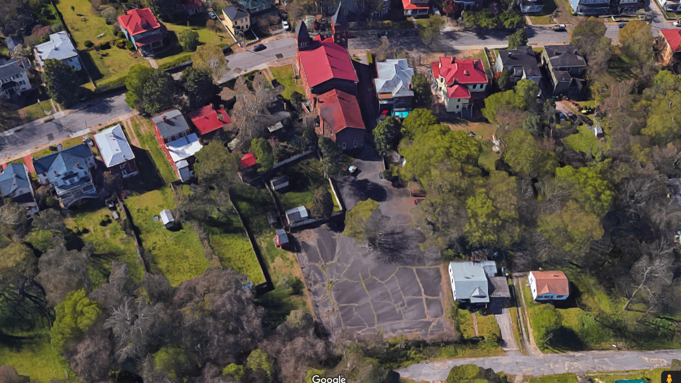
Aerial looking South

Slide 13
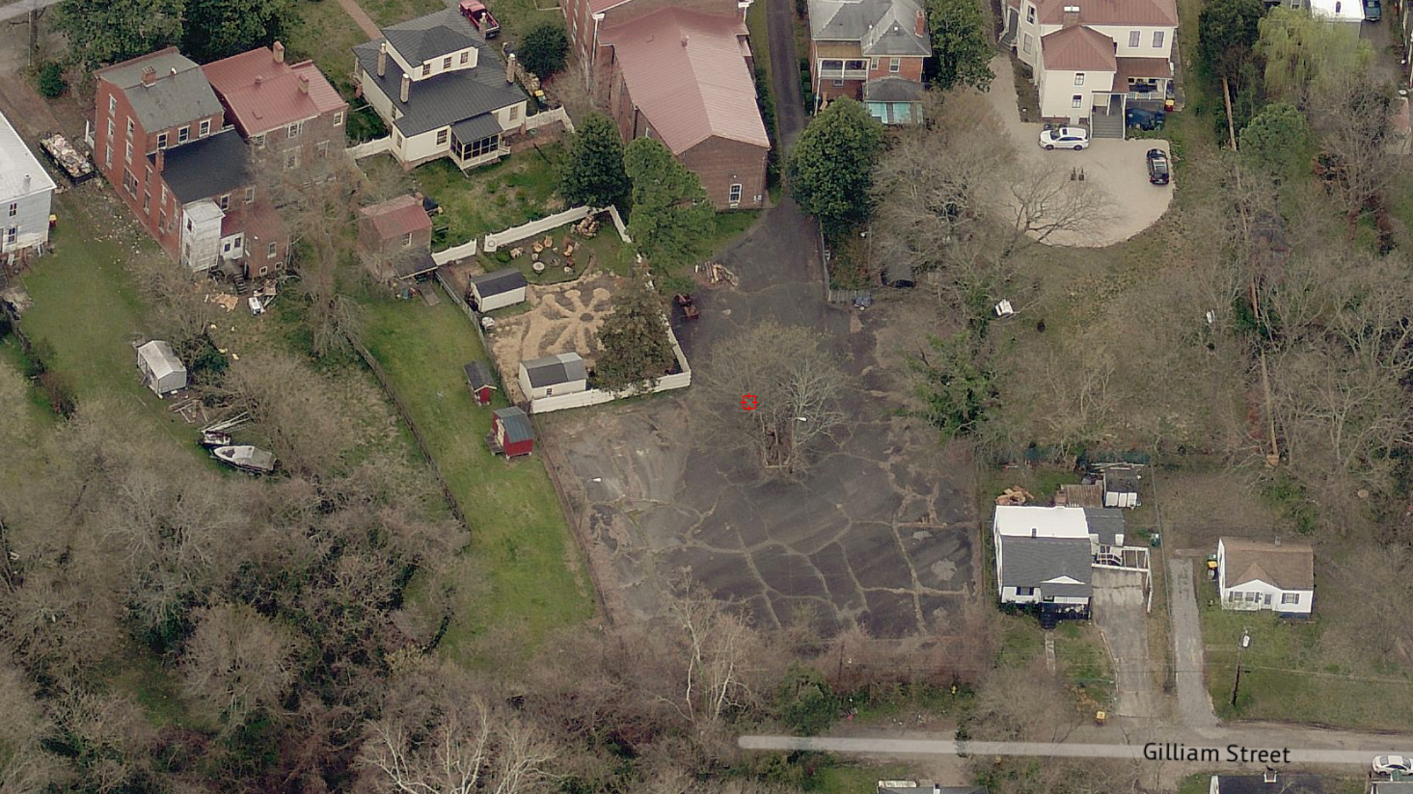
Aerial looking South

Slide 14
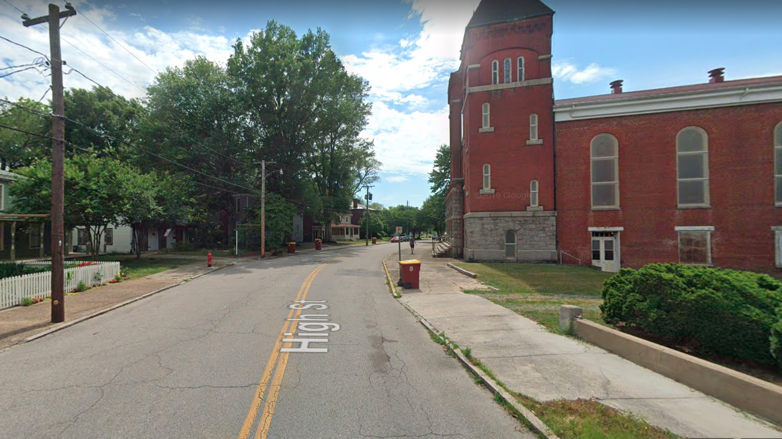
High Street
Looking West

Slide 15
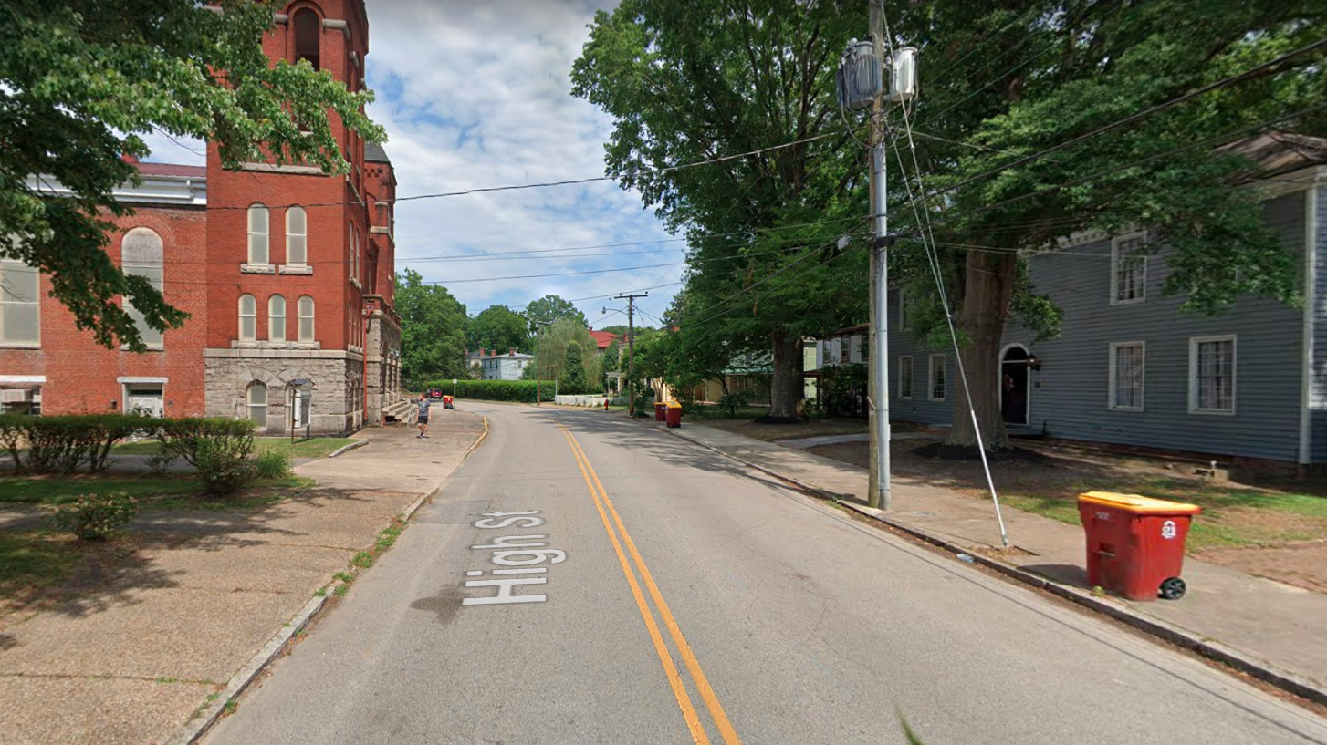
High Street
Looking East

Slide 16
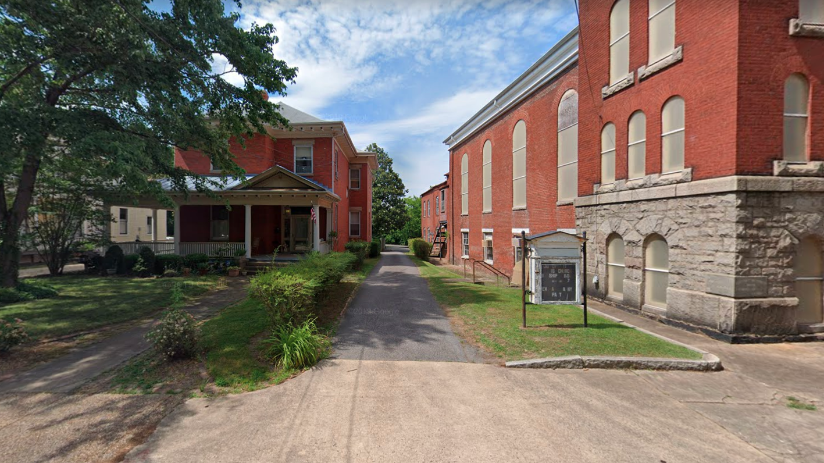
High Street
West Side of Building

Slide 17
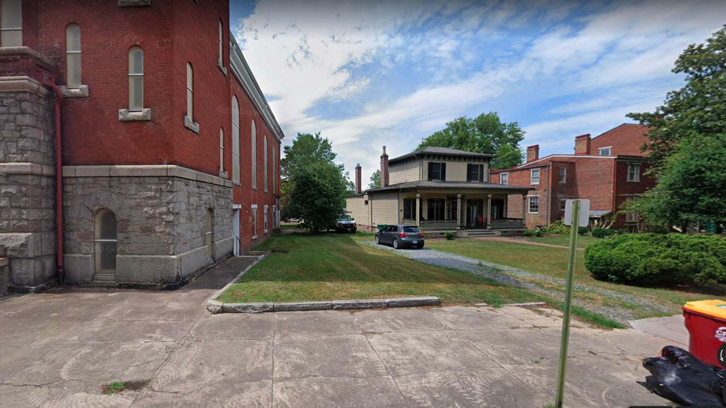
High Street
East Side of Building

