Slide 1
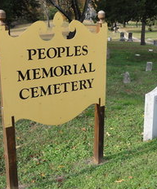
Update DHR Grant for People’s Memorial Cemetery
September 1, 2020

Slide 2
Chapter 22 Title 10.1 of the Code of Virginia
Department of Historic Resources “DHR” was enacted to support the preservation and protection of the Commonwealth of Virginia’s significant historic, architectural, archaeological, and cultural resources.
The Code of Virginia authorizes the Director (of DHR) “to manage and administer the Historical African American Cemeteries and Graves Fund as provided in section §10.1-2211.3.”
The Code of Virginia also authorizes DHR to “disburse funds to any qualified organization to fund maintenance and care of additional historical African American graves in the Commonwealth that have been certified by the Department and documented in the Department’s cultural resources database.”
A “Historical African American cemetery” is defined as ”a cemetery that was established prior to January 1, 1900, for the interment of African Americans.”

Slide 3
Chapter 22 Title 10.1 of the Code of Virginia
§10.1-2211.2 also states that “any representative of a qualified organization desiring to receive funding from such appropriation for the maintenance of qualifying cemeteries and graves …. shall submit an application to the Department on or before May 30 each year.”
Monies provided for under this Code section in the general appropriation act shall be used exclusively for the purpose of maintaining and preserving historical African-American cemeteries by qualifying organizations (hereinafter referred to as “organizations”).
Such funds are appropriated on the basis of the number of graves, monuments, and markers in the qualifying cemetery multiplied by the rate of $5.

Slide 4
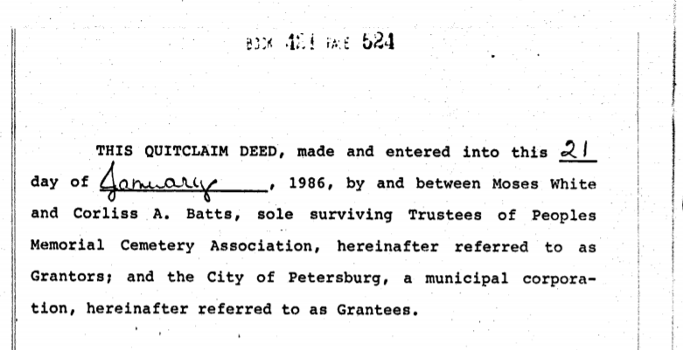
City Acquisition of People’s Cemetery January 21, 1986

Slide 5
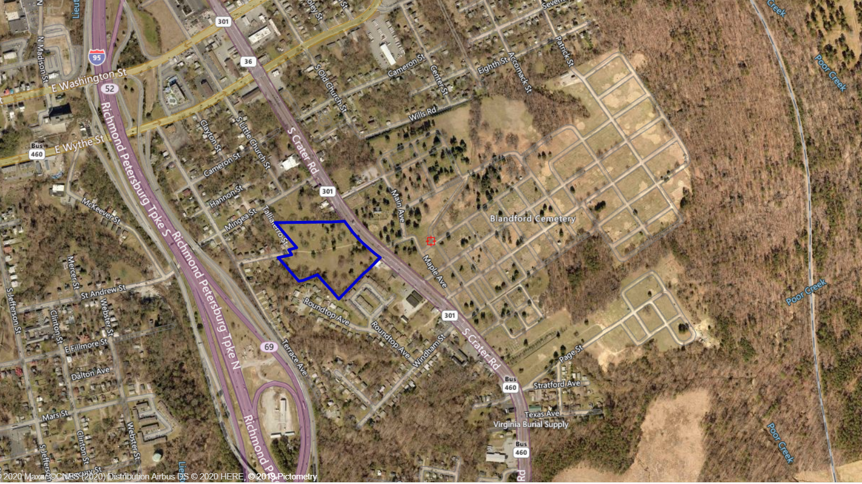
People’s Cemetery Location
Crater Road
Blandford Cemetery
People’s Cemetery
I-95

Slide 6
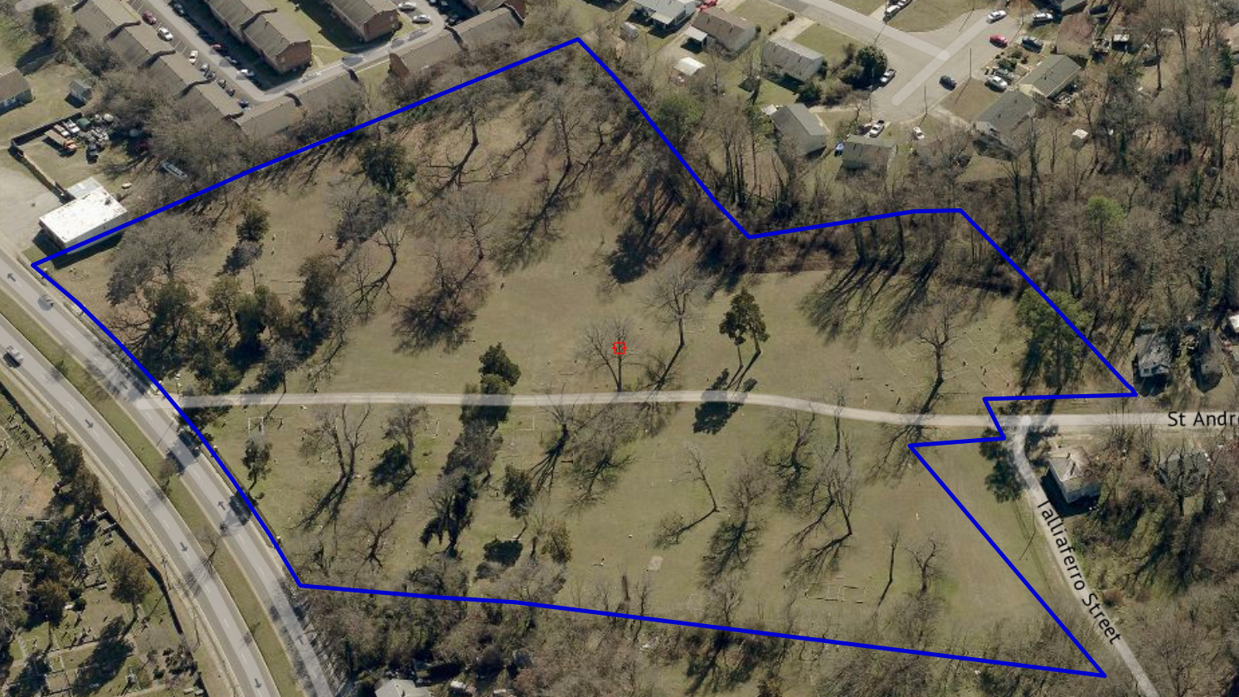
People’s Cemetery Parcel Looking South

Slide 7
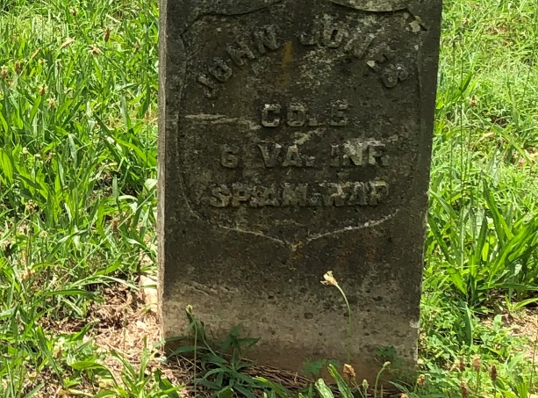
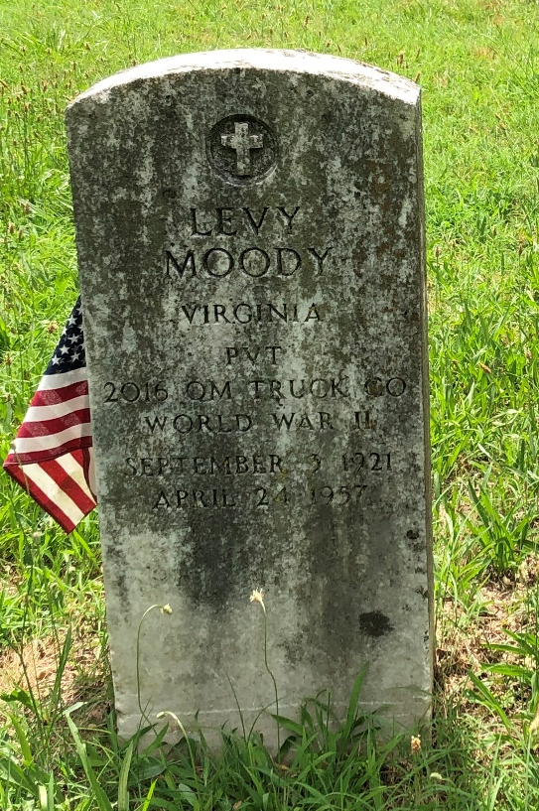
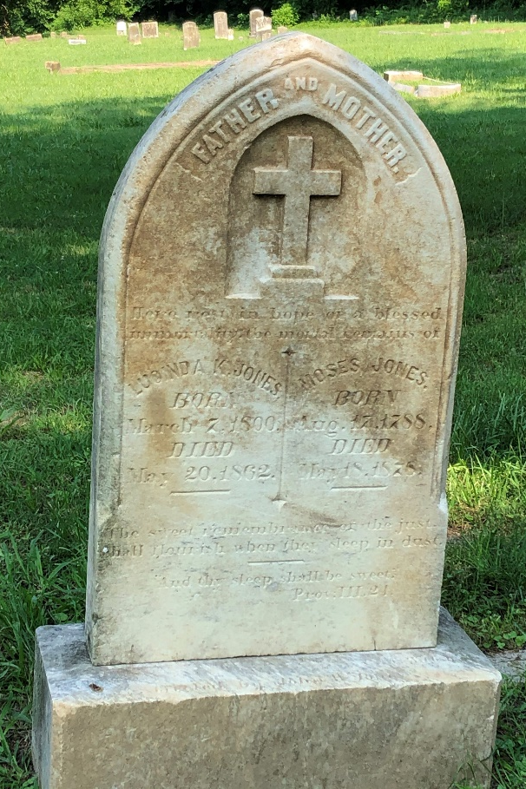
The Interred
Mr. Moses Jones
August 1788 – March 1876
Ms. Lucinda Jones
March 1800 – May 1862
John Johns
Spanish-American War Veteran
Levy Moody
World War II Veteran

Slide 8
DHR Architectural Survey Completed June 25, 2020 (Identified 300 Qualifying Graves)
Cemetery Information included in Survey:
Current Use: | Memorial Park
Historic Religious Affiliation: | None
Ethnic Affiliation: | No Data
Has Marked Graves: | True
Has Unmarked Graves: | False
Enclosure Type: | None
Number Of Gravestones: | 101 - 999
Earliest Marked Death Year: | 1840
Latest Marked Death Year: | 1998
Included on the National Register of Historic Places: | Yes

Slide 9
August 10, 2020 Application Confirmation
The City received confirmation that the application and accompanying documents appear to be in order and, therefore, DHR will proceed with listing the cemetery as eligible for annual funding from the African American Cemetery and Graves Fund.
DHR must confirm that the number of eligible graves is correct, then draft agreements for the grant between the City and DHR.

Slide 10
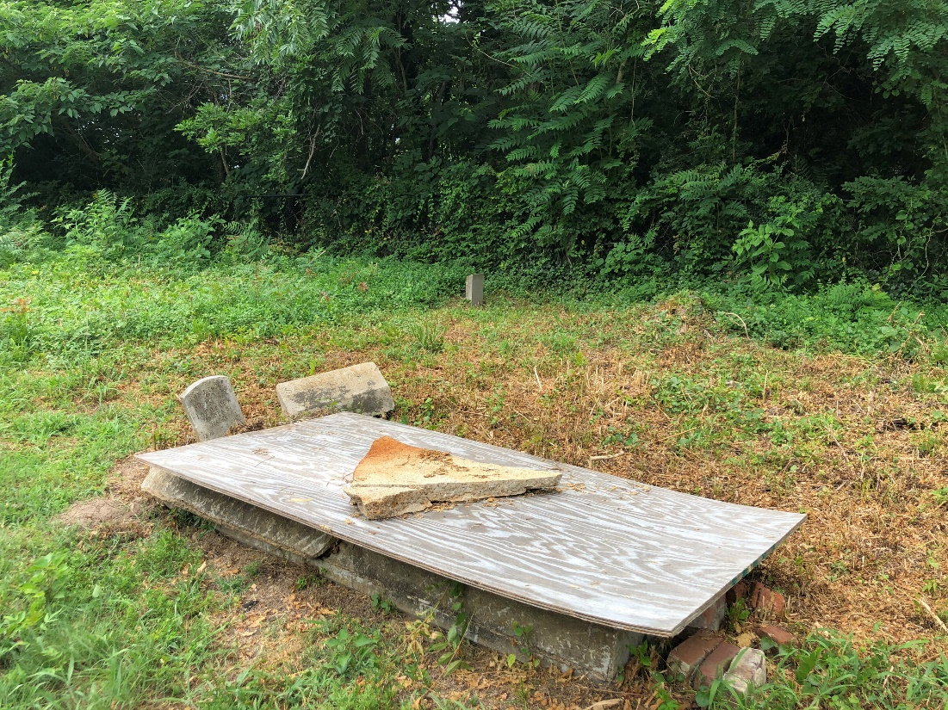
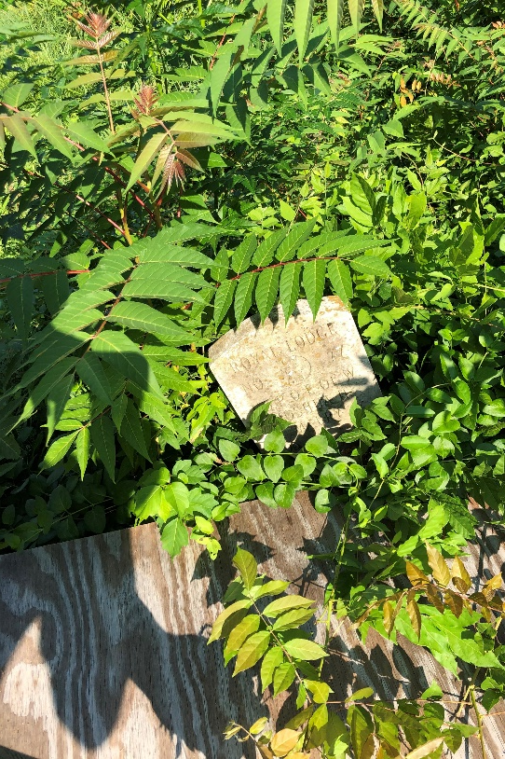
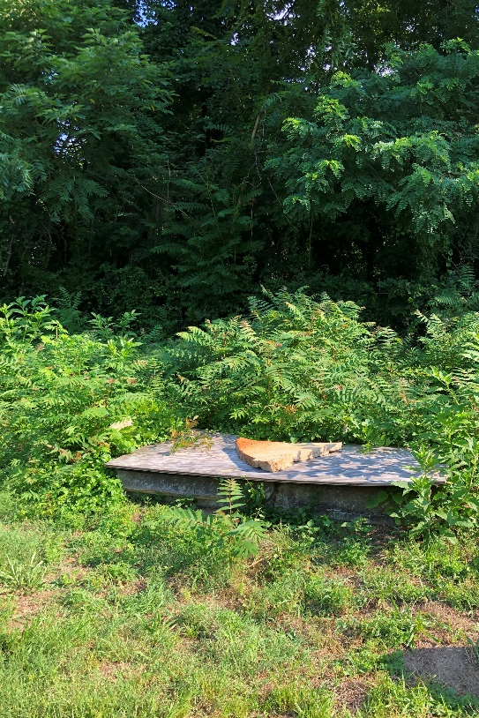
Joshua H. Mabry
1895 – 1952
Royal Lodge
No. 77

Slide 11
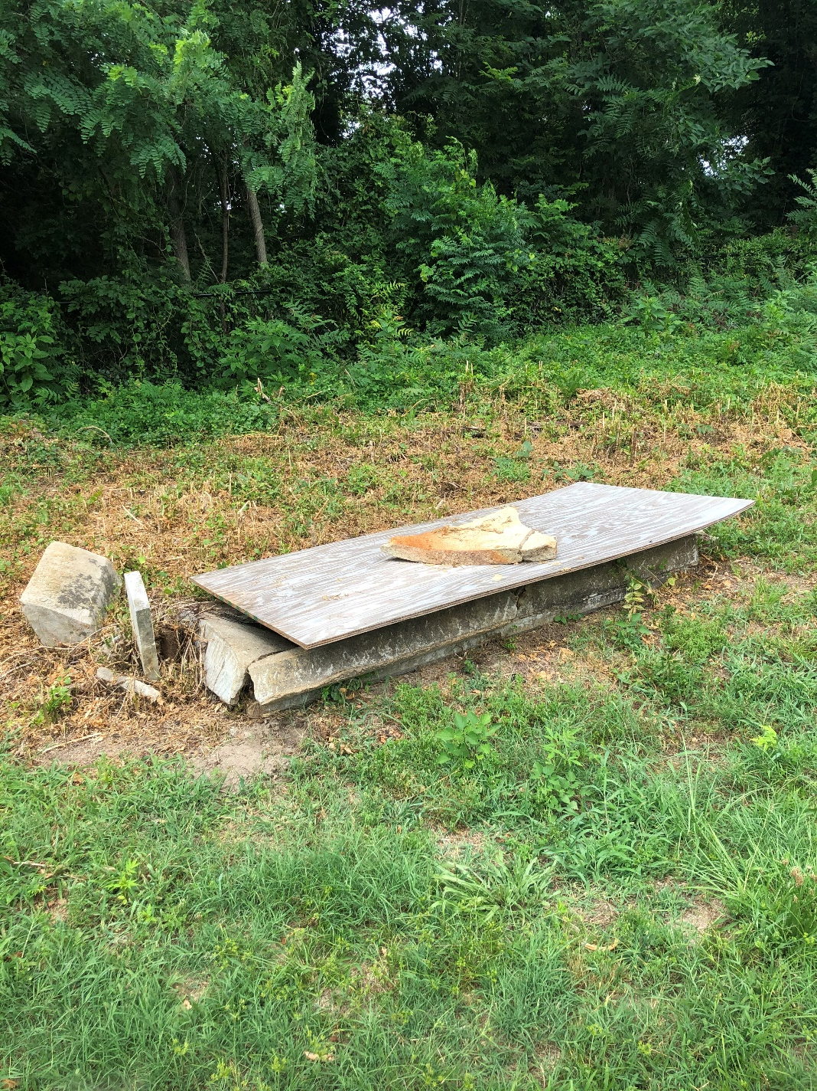
Use of Funds
Half of the funding will be utilized for repairing/ replacing this damaged gravestone slab

Slide 12
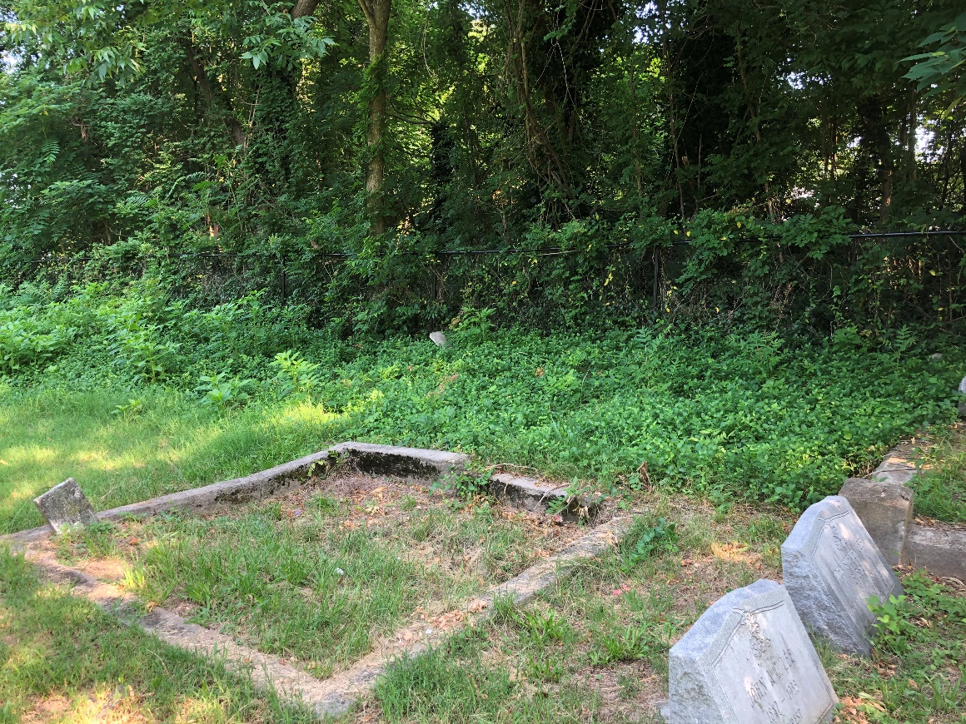
Use of Funds
Half of the funding will be utilized for maintaining the invasive brush which Public Works maintains along the fence line of the Cemetery
The brush easily overtakes some graves along the fence

