Slide 1

Comprehensive Plan
2020-21

Slide 2
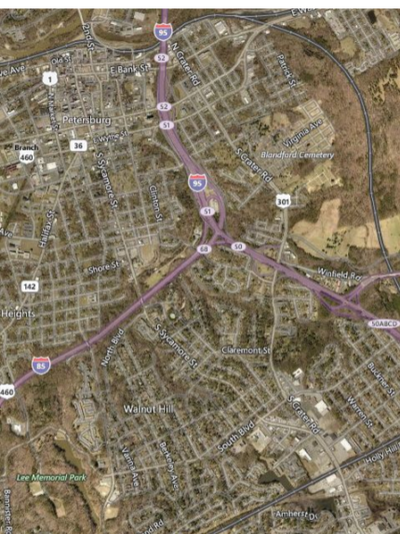
Code of Virginia
Article 3.
The Comprehensive Plan.
§ 15.2-2223. Comprehensive Plan to be prepared and adopted scope and purpose.
The local Planning Commission shall prepare and recommend a Comprehensive Plan for the physical development of the territory within its jurisdiction and every governing body shall adopt a Comprehensive Plan for the territory under its jurisdiction.

Slide 3
Code of Virginia
Article 3.
The Comprehensive Plan.
In the preparation of a Comprehensive Plan the commission shall make careful and comprehensive surveys and studies of the existing conditions and trends of growth and of the probable future requirements of its territory and inhabitants.

Slide 4
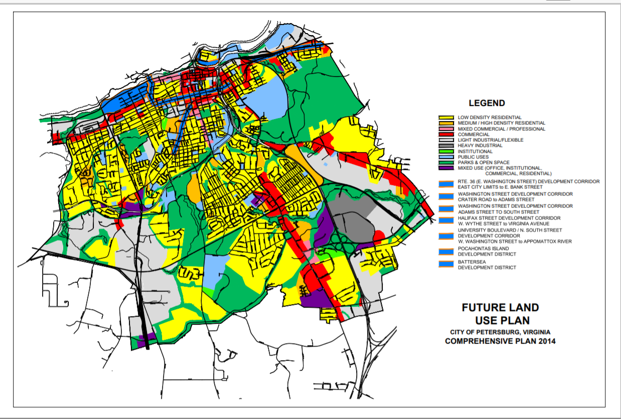
Long-Range Planning
The Comprehensive Plan with the accompanying maps plats charts and descriptive matter shall show the locality's long-range recommendations for the general development of the territory covered by the plan.

Slide 5
Code of Virginia
Article 3. The Comprehensive Plan.
The Comprehensive Plan shall be made with the purpose of guiding and accomplishing a coordinated, adjusted, and harmonious development of the territory which will in accordance with present and probable future needs and resources to best promote the;
  Health
  Safety
  Morals
  Order
  Convenience
  Prosperity
  General Welfare of the Inhabitants Including the Elderly and Persons with Disabilities.

Slide 6
The Plan may include but need not be limited to:
Areas for public and private development
The designation of a system of community service facilities
Historical areas and areas for urban renewal or other treatment
Sustainable measures to provide quality groundwater and surface water
A capital improvements program
A subdivision ordinance
A zoning ordinance
Zoning district maps
Agricultural and forestal district maps where applicable
The location of existing or proposed recycling centers
The location of military bases military installations and their adjacent safety areas
The designation of routes for electric transmission lines of 150 kilovolts or more
The designation of areas and for affordable housing,
Strategies to provide broadband infrastructure

Slide 7
5-Year Review
Code of Virginia :
15.2-2230. Plan to be reviewed at least once every five years.
At least once every five years the comprehensive plan shall be reviewed by the local planning commission to determine whether it is advisable to amend the plan.

Slide 8
Analysis
2000
2010
2020
2030
2040
Past
Present
Future
Past Conditions
Trends and Projections
Who we were Who we are Who we aspire to be
Descriptive
Prescriptive
Assets Needs Challenges Opportunities Interventions Priorities

Slide 9
Plan Sections
Acknowledgements
What is The Comprehensive Plan
Community Engagement Plan
Identity: Who we were, Who we are, Who we aspire to be
Elements
Current Land Use
Future Land Use

Slide 10
Plan Elements
Health
  Health Plan
  Social Services Plan
Wealth
  Economic Development Plan
  Tourism Plan
  Housing Plan
Wisdom
  Education Plan
  Workforce Development Plan
Quality of Life
  Arts and Culture Plan
  Parks, Recreation and Open Space Plan
  Historic Preservation Plan
  Sacred Places and Spaces Plan
Mobility
  Transportation Plan
    Complete Streets Plan
    Bike/Walk Plan
  Infrastructure Plan
    Streets Plan
    Utility Infrastructure Plan
  Capital Improvement Plan (CIP)
Environment
  Environmental Plan
  Chesapeake Bay Plan
  Resiliency Plan
Safety
  Public Safety Plan
    Police
    Fire

Slide 11
Framework
For Each Element
Vision – What is the Preferred Future for the Element
Goals leading to realizing the Vision
Actions to achieve the Goals
Evaluation – Measures of Success
Implementation Schedule and Timeline | 5 Years (2025) | 10 Years (2030) | 20 Years (2040)

Slide 12
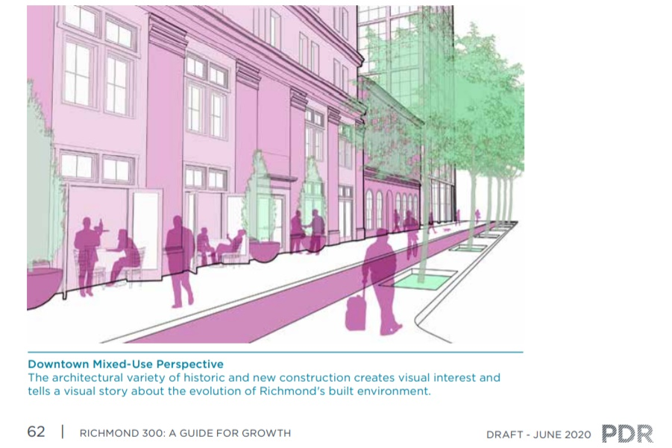
Representations
Maps
Charts and Graphs
Drawings
Photos
Schematics

Slide 13

Community Engagement
Surveys regarding Elements
Comments on Plan Drafts
Community Conversations (Virtual)
Presentations and Contact List Development
  City Council Meetings
  Ward Meeting
  Churches
  Neighborhood Organizations
  Community Ambassadors

Slide 14
Transportation Plan
Each locality shall develop a transportation plan as part of the Comprehensive Plan
It designates a system of transportation infrastructure needs and recommendations
It designates new and expanded transportation facilities that support the planned development of the City covered by the plan.

Slide 15
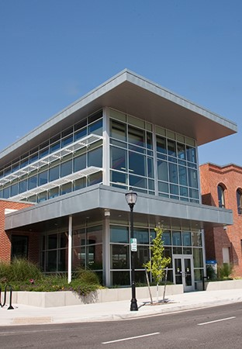
Transportation
Plan
The Transportation Plan
Shall include as appropriate but
not be limited to:
Roadways
Bicycle Accommodations
Pedestrian Accommodations
Railways
Bridges
Waterways
Airports
Ports
Public Transportation Facilities

Slide 16
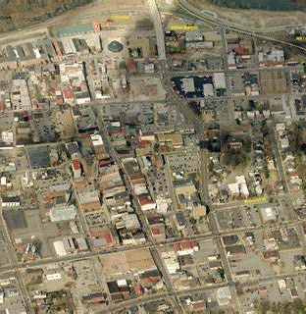
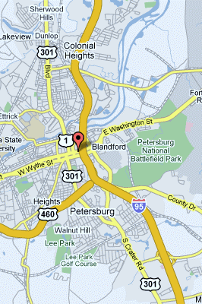
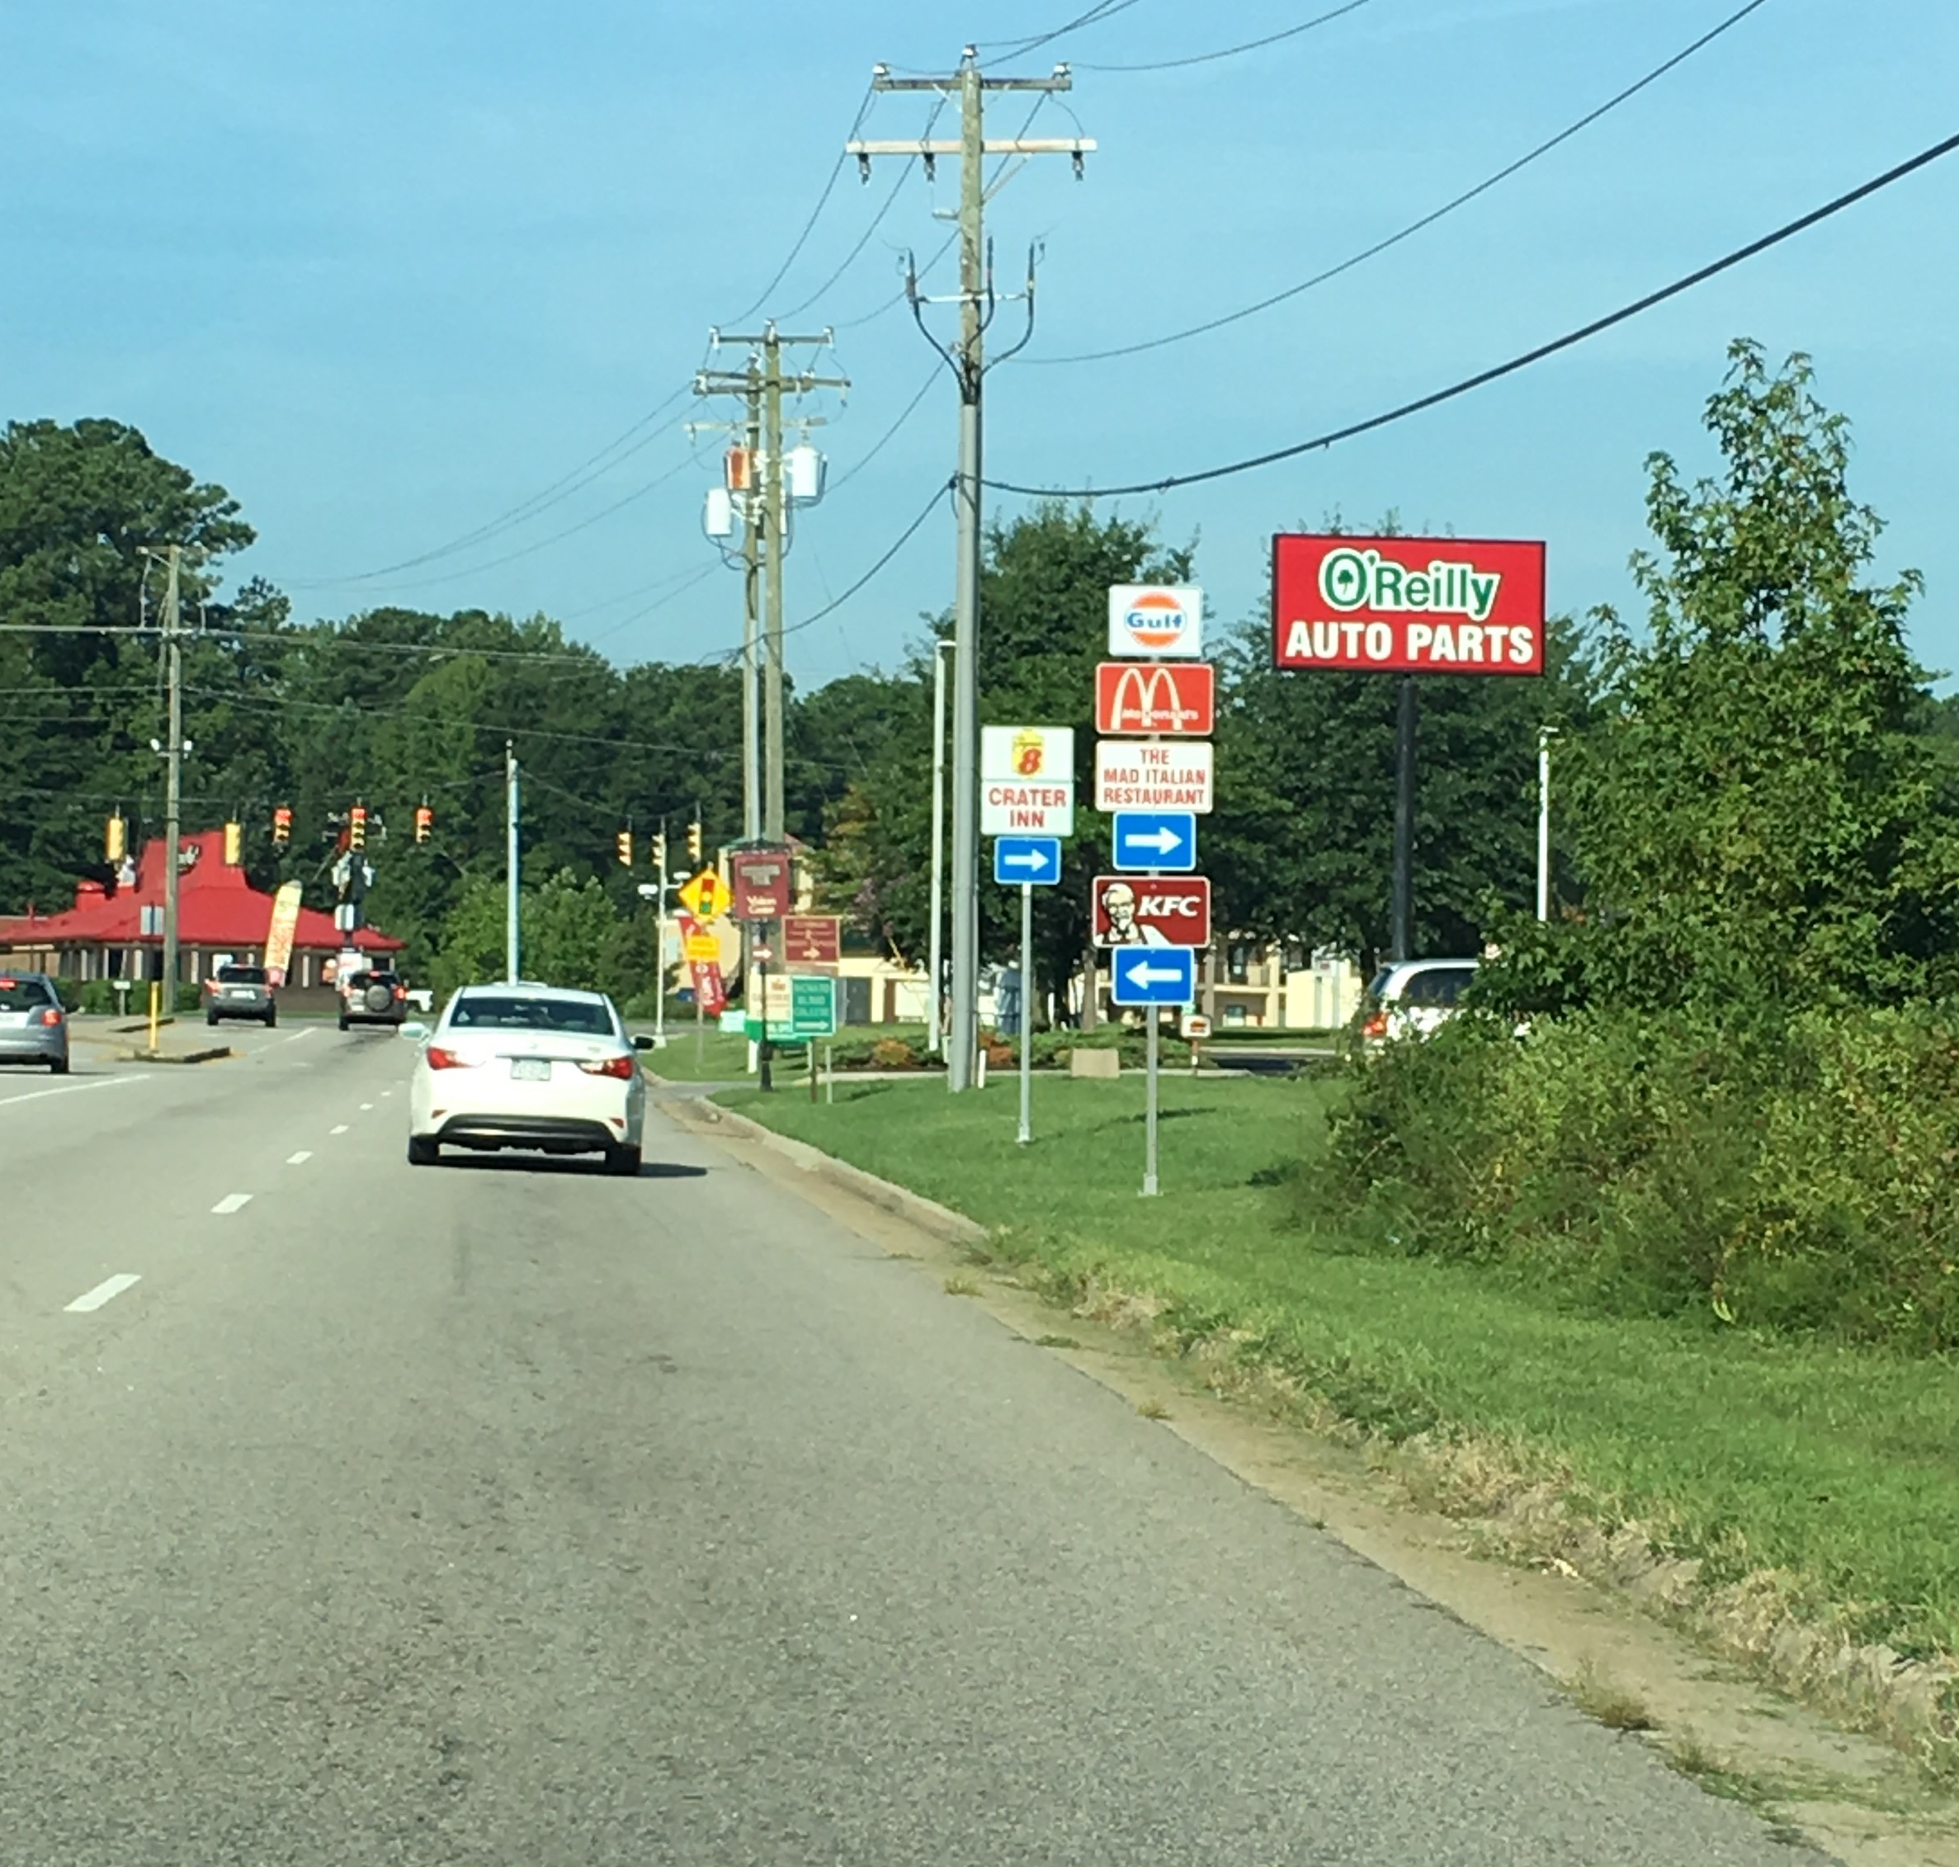
Transportation Plan
The plan shall recognize and differentiate among a hierarchy of roads such as;
  Expressways
  Arterials
  Collectors
  Local Streets

Slide 17
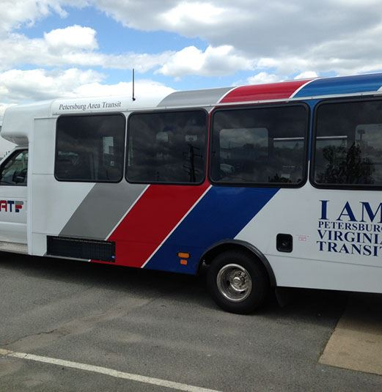

Transportation Plan
In developing the plan the locality shall take into consideration how to align transportation infrastructure and facilities with affordable accessible housing and community services that are located within the territory in order to facilitate community integration of the elderly and persons with disabilities.
The Virginia Department of Transportation shall upon request provide localities with technical assistance in preparing such transportation plan.

Slide 18
Schedule
 | Date | Action
2020 | July 1 | Establish a Schedule for the Update
 | July – September | Engaged Surveys and Studies of Existing Conditions
 | September 2 | Planning Commission Review
 | October – December | Engaged Surveys and Studies Trends of Growth
 | December 2 | Planning Commission Review
2021 | January – March | Probable Future Requirements
 | March 3 | Planning Commission Review
 | April – June | Probable Future Requirements
 | May 18 | Submission to City Council for Consideration
 | June 1 | Public Hearing Consideration by the City Council

